Slide 1



fNIRS simulation and Reconstruction

Slide 2
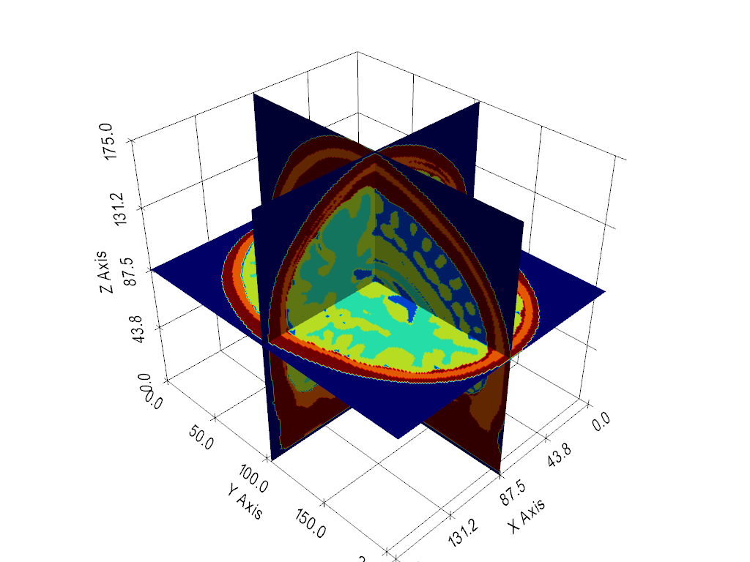
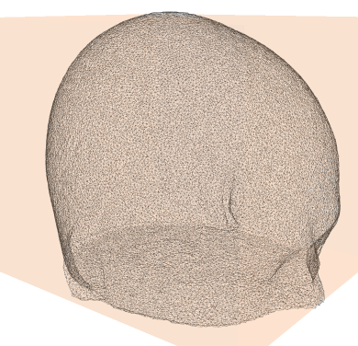
3D head mesh

Slide 3
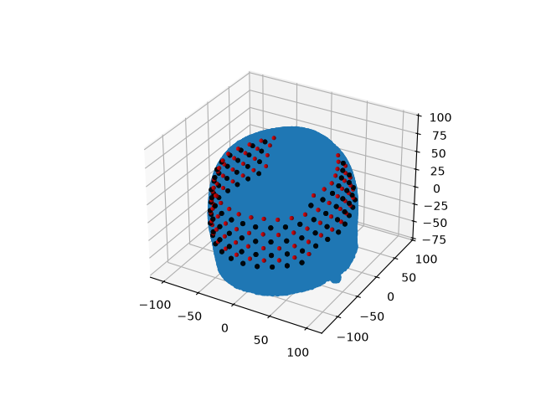
Optode placement
We have used the WashU HD-DOT 96 sources and 92 detectors
Can used your own
  Make sure the coordinates are in MNI space
  Use ‘touch_optodes()’ to ensure correct placement

Slide 4
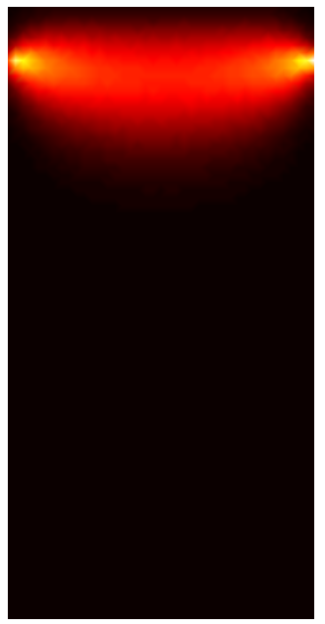
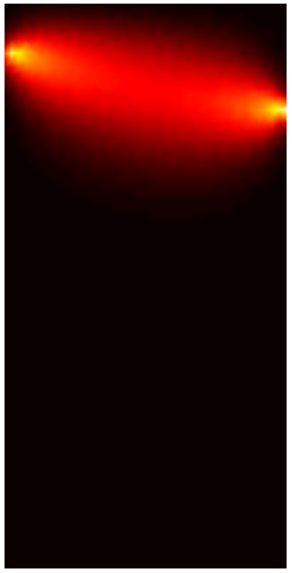
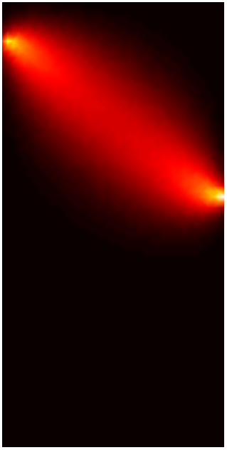
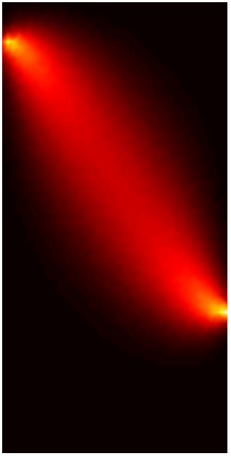
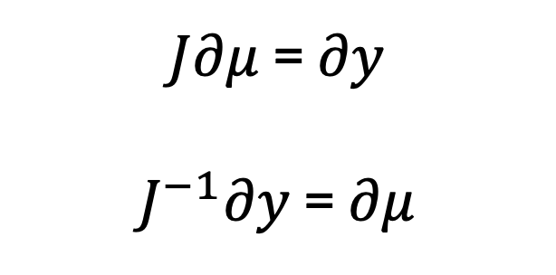
Image Reconstruction
The Jacobian (Weigh Matrix, A Matrix, Sensitivity matrix):
Relates a small change in optical properties to a change in measured data
calculated using the adjoint method
$J∂μ$ = $∂y$
$J^{−1}∂y$ = $∂μ$
Remember this slide!

Slide 5
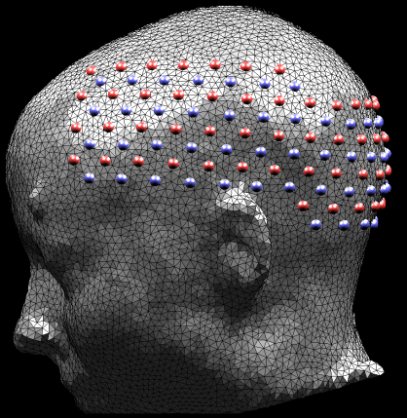
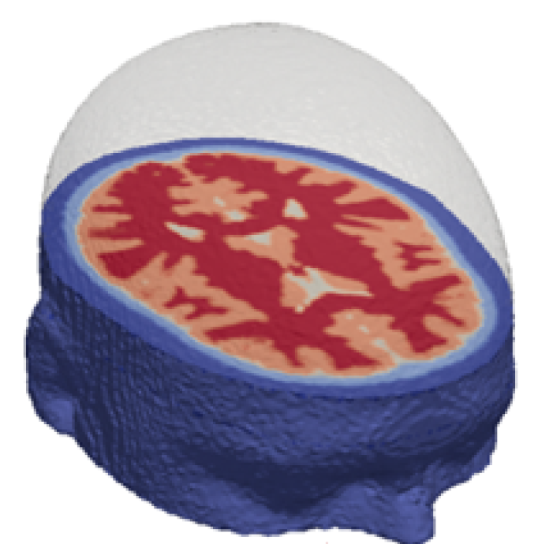
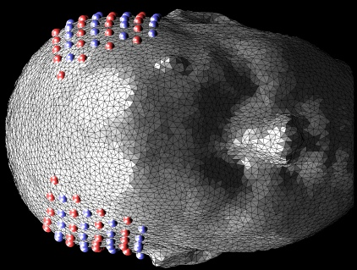
Under-determined
Need to recover many unknowns (~40k - 500k)
Finite and discrete number of measurements (~100 – 1000)
$J$ = NM x NV=(1000)x(500,000)

Slide 6
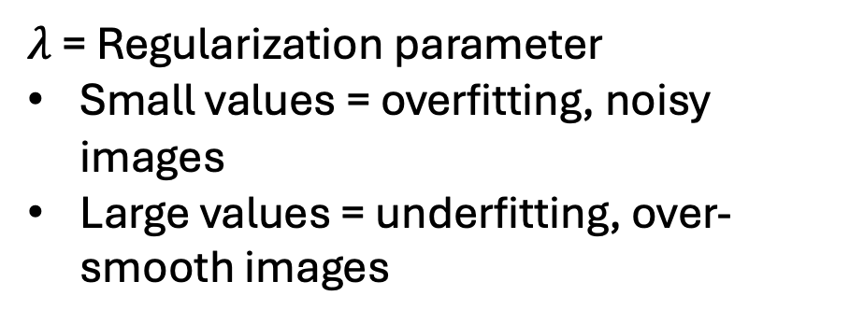
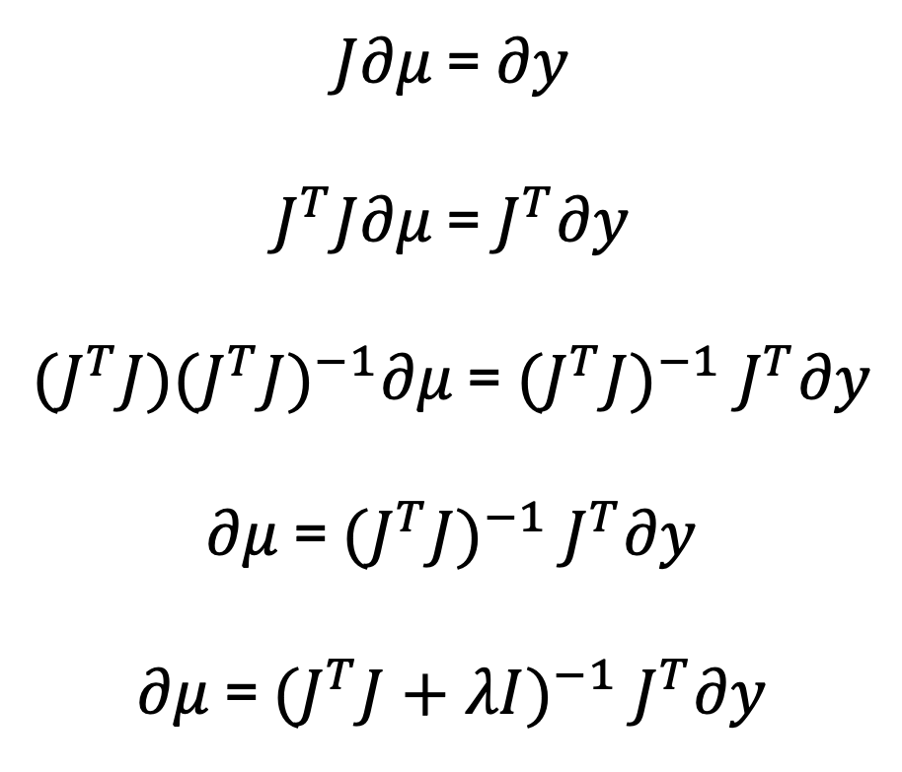
Matrix inversion
$J∂μ$ = $∂y$
$J^{T}J∂μ$ = $J^{T}∂y$
${(J}^{T}J){(J^{T}J)}^{−1}∂μ$ = ${(J^{T}J)}^{−1} J^{T}∂y$
$∂μ$ = ${(J^{T}J)}^{−1} J^{T}∂y$
$∂μ$ = ${(J^{T}J+λI)}^{−1} J^{T}∂y$
$λ$ = Regularization parameter
Small values = overfitting, noisy images
Large values = underfitting, over-smooth images

Slide 7

Creating the bananas!

Slide 8
Creating the bananas!
S
d
Perturbation model
  For every source s
  For every detector d
  Model reference data, Y_{ref(s,d)}

Slide 9
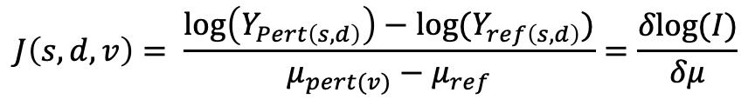
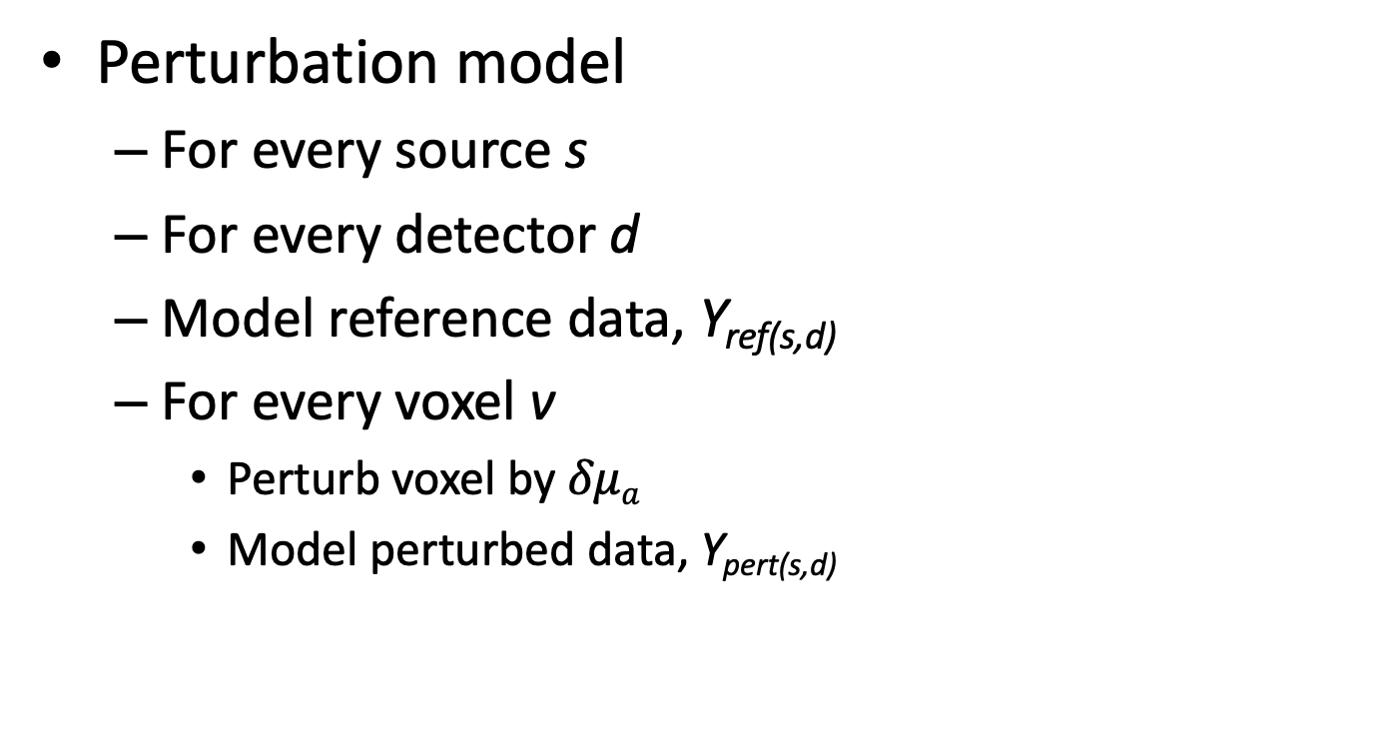
Creating the bananas!
S
d
Perturbation model
  For every source s
  For every detector d
  Model reference data, Y_{ref(s,d)}
  For every voxel v
    Perturb voxel by $δμa$
    Model perturbed data, Y_{pert(s,d)}
$$J\left(s,d,v\right)= \frac{\log\left(Y_{Pert\left(s,d\right)}\right)−log⁡(Y_{ref\left(s,d\right)})}{μ_{pert(v)}−μ_{ref}}=\frac{δlog⁡(I)}{δμ}$$

Slide 10
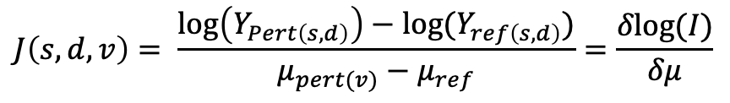
Creating the bananas!
S
d
Perturbation model
  For every source s
  For every detector d
  Model reference data, Y_{ref(s,d)}
  For every voxel v
    Perturb voxel by $δμa$
    Model perturbed data, Y_{pert(s,d)}
$$J\left(s,d,v\right)= \frac{\log\left(Y_{Pert\left(s,d\right)}\right)−log⁡(Y_{ref\left(s,d\right)})}{μ_{pert(v)}−μ_{ref}}=\frac{δlog⁡(I)}{δμ}$$

Slide 11
Creating the bananas!
S
d
Perturbation model
  For every source s
  For every detector d
  Model reference data, Y_{ref(s,d)}
  For every voxel v
    Perturb voxel by $δμa$
    Model perturbed data, Y_{pert(s,d)}
$$J\left(s,d,v\right)= \frac{\log\left(Y_{Pert\left(s,d\right)}\right)−log⁡(Y_{ref\left(s,d\right)})}{μ_{pert(v)}−μ_{ref}}=\frac{δlog⁡(I)}{δμ}$$

Slide 12
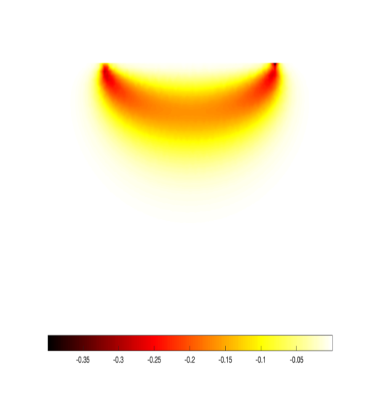
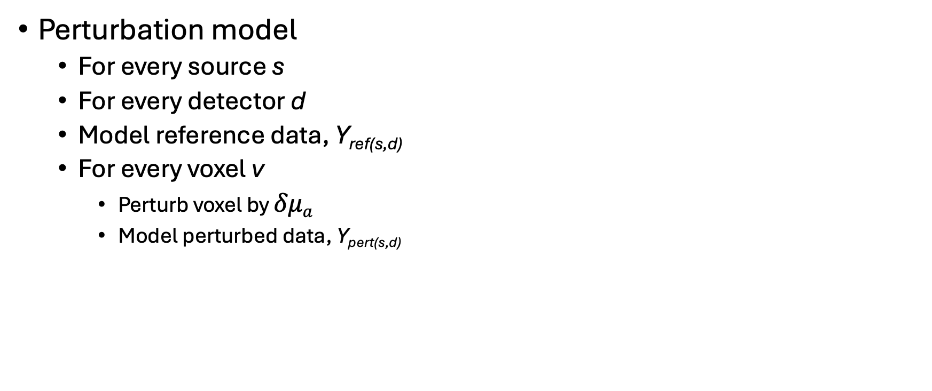
Creating the bananas!
S
d
Perturbation model
  For every source s
  For every detector d
  Model reference data, Y_{ref(s,d)}
  For every voxel v
    Perturb voxel by $δμa$
    Model perturbed data, Y_{pert(s,d)}
$$J\left(s,d,v\right)= \frac{\log\left(Y_{Pert\left(s,d\right)}\right)−log⁡(Y_{ref\left(s,d\right)})}{μ_{pert(v)}−μ_{ref}}=\frac{δlog⁡(I)}{δμ}$$

Slide 13
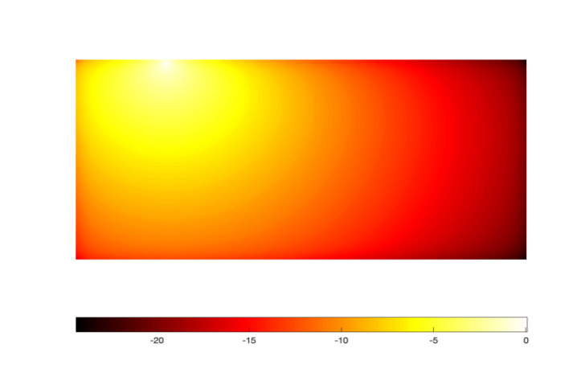
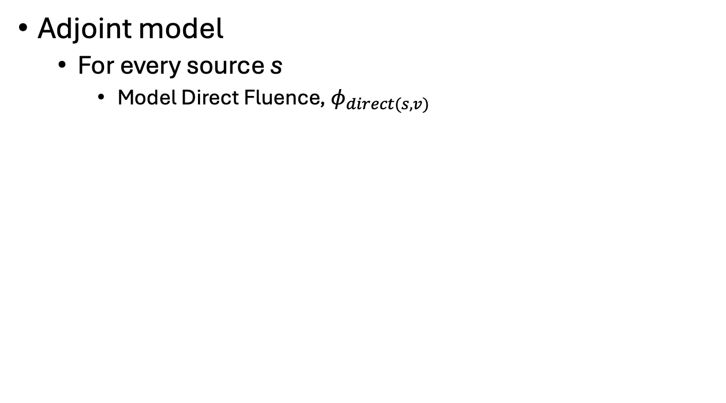
Creating the bananas!
S
d
Adjoint model
  For every source s
    Model Direct Fluence, $φ_{direct(s,v)}$

Slide 14
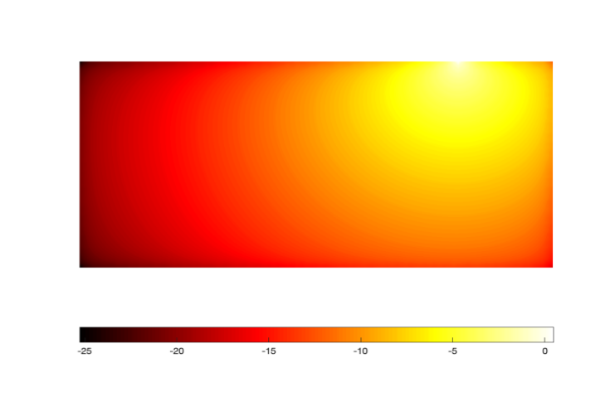
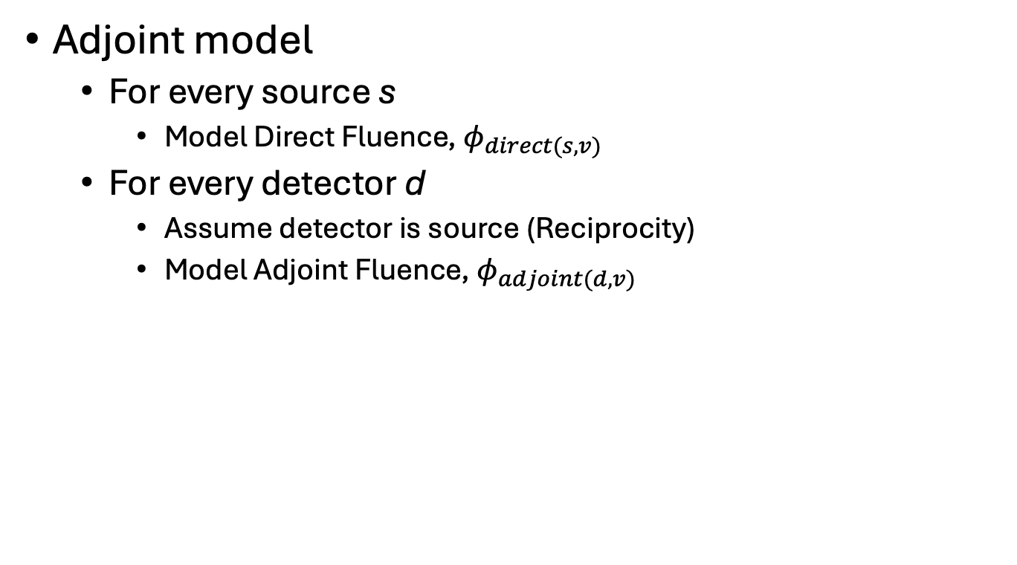
Creating the bananas!
S
d
Adjoint model
  For every source s
    Model Direct Fluence, $φ_{direct(s,v)}$
  For every detector d
    Assume detector is source (Reciprocity)
    Model Adjoint Fluence, $φ_{adjoint(d,v)}$

Slide 15
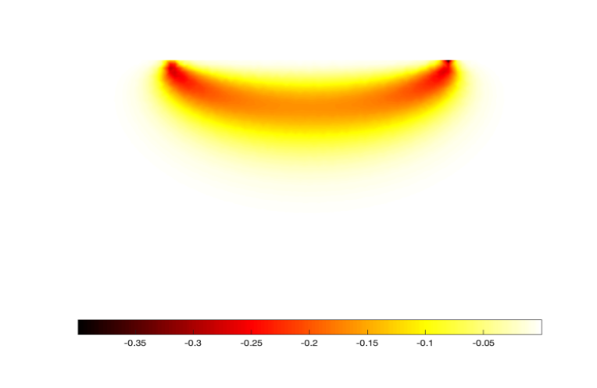
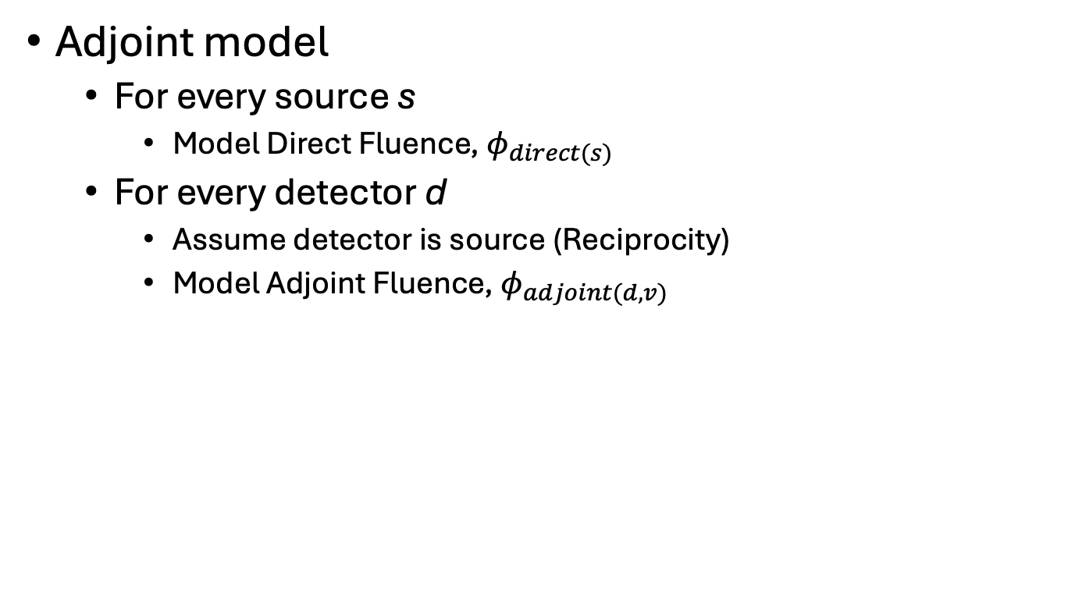

Creating the bananas!
S
d
Adjoint model
  For every source s
    Model Direct Fluence, $φ_{direct(s)}$
  For every detector d
    Assume detector is source (Reciprocity)
    Model Adjoint Fluence, $φ_{adjoint(d,v)}$
$J\left(s,d,v\right)=$ $φ_{direct(s,v)}×φ_{Adjoint(d,v)}$

Slide 16
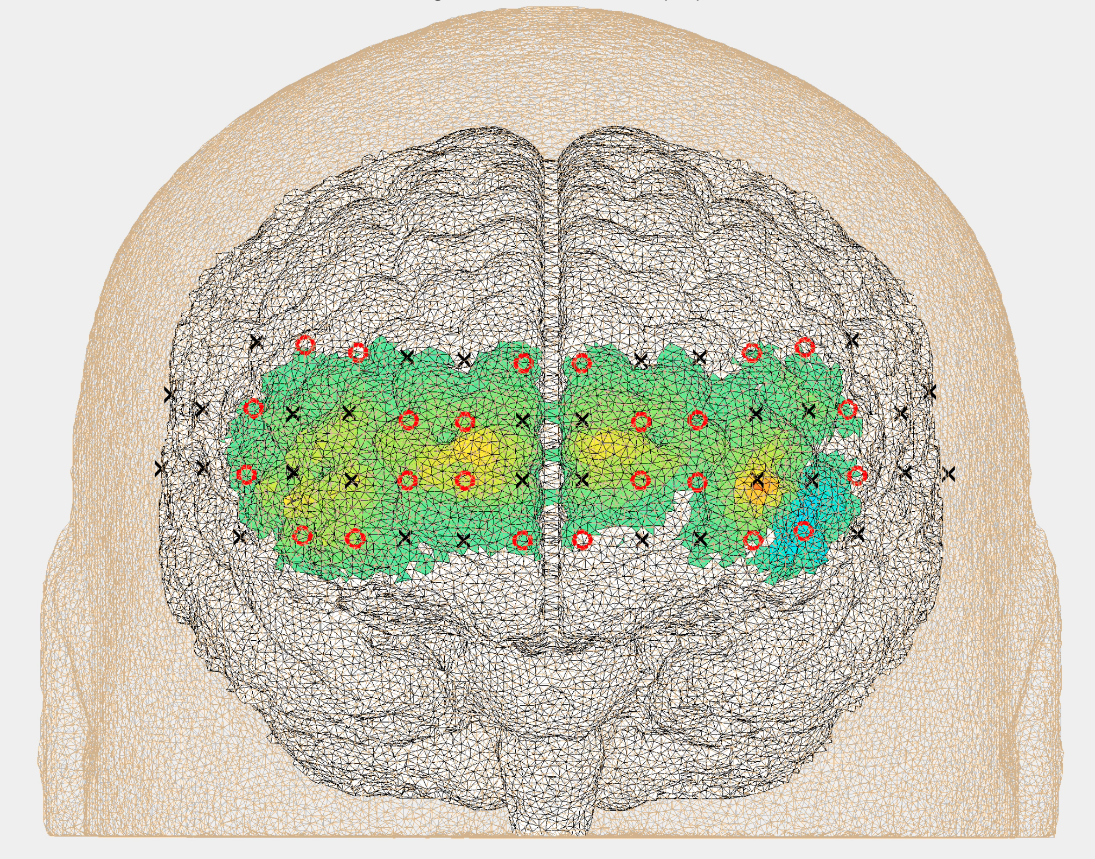
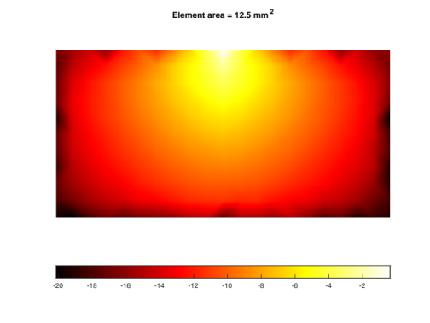
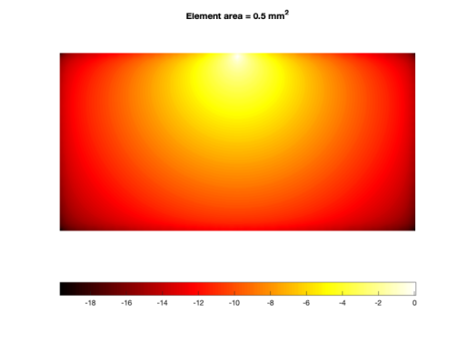
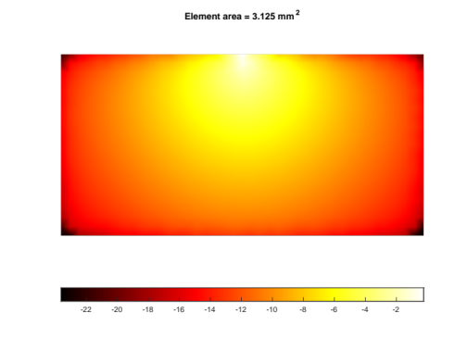

Reconstruction Basis
Need to recover many unknowns (~40k - 500k)
Finite and discrete number of measurements (~100 – 1000)
But we need the model to have high enough resolution for numerical accuracy

Slide 17
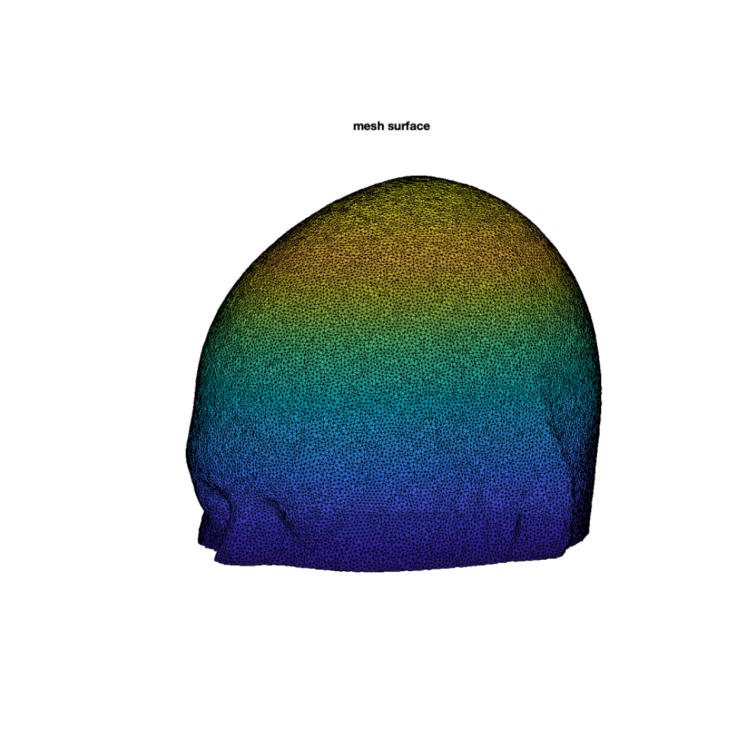
Reconstruction Basis
Solution
  Calculate Jacobian on a high-resolution mesh
  Interpolate onto coarser ‘Reconstruction Basis’
    Voxels
    Second mesh
    Regions
  Calculate update
  Map back onto mesh

Slide 18
Brain Parcelization
The Gordon parcellation (Gordon et al., 2014) is a widely used human brain atlas
Divides the cerebral cortex into 333 distinct regions of interest (ROIs) based on resting-state functional connectivity boundary mapping
These 333 parcels are organized into 13 functional networks (or areas)

Slide 19
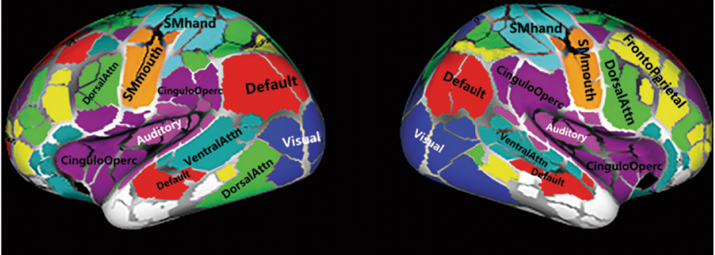
Brain Parcelization
Auditory (Aud)
Cingulo-Opercular (CiO / CON)
Cingulo-Parietal (CiP)
Default Mode Network (Def / DMN)
Dorsal Attention Network (DoA / DAN)
Fronto-Parietal Network (FrP / FPN)
Retrosplenial-Temporal (ReT)
Somatomotor Hand (SMh)
Somatomotor Mouth (SMm)
Salience (Sal)
Ventral Attention Network (VeA / VAN)
Visual (Vis)
Unassigned / None (Parcels with low signal or those that do not map cleanly into a single system)

Slide 20
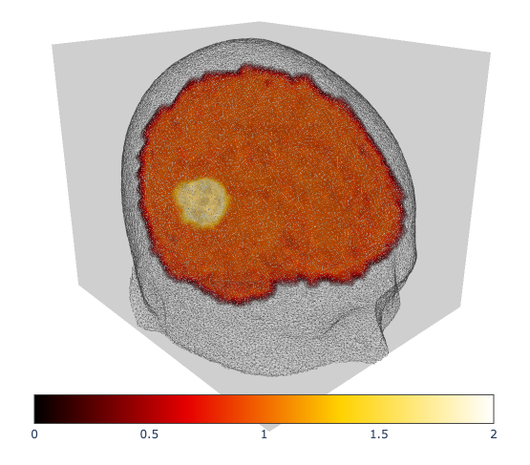
Example: Auditory
parcel = "Auditory"
side = "right"
size = 15

Slide 21
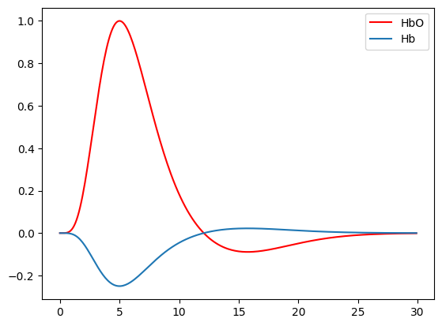
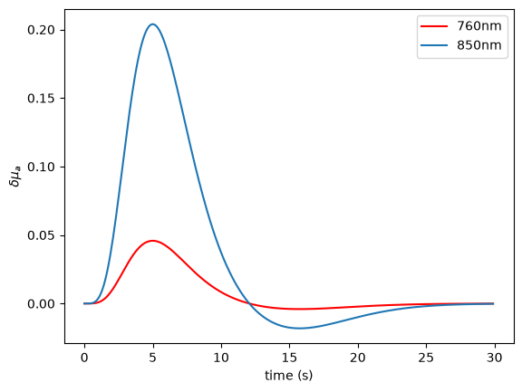
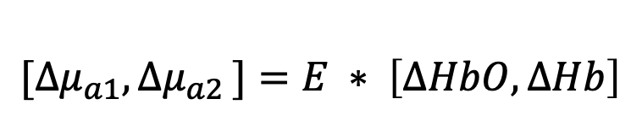
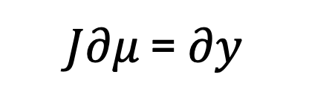
HRF to optical properties
Using extinction Coefficients of HbO and HbR, we can convert HRF to changes in Absorption
$${[∆μ}_{a1}{, ∆μ}_{a2}]=E ∗ \left[∆HbO,∆Hb\right]$$
$J∂μ$ = $∂y$
Note, we only perturb ($∂μ)$voxels (nodes) in the activated region

Slide 22
Parameter Recovery
We can use MBL (same as last example) to get a global (or channel) measure
We can use Jacobian, invert and reconstruct
Follow example notebook

Slide 23
Questions?

